Slide 1

Comparative analysis of machine learning methods for analyzing security practice in electronic health records’ logs.
By: Prosper K. Yeng, Muhammad A. Fauzi, Bian Yang:
Norwegian University of Science and Technology

Slide 2
Outline
Motivation
Background
Objective/Research Question
Discussion
Results

Slide 3
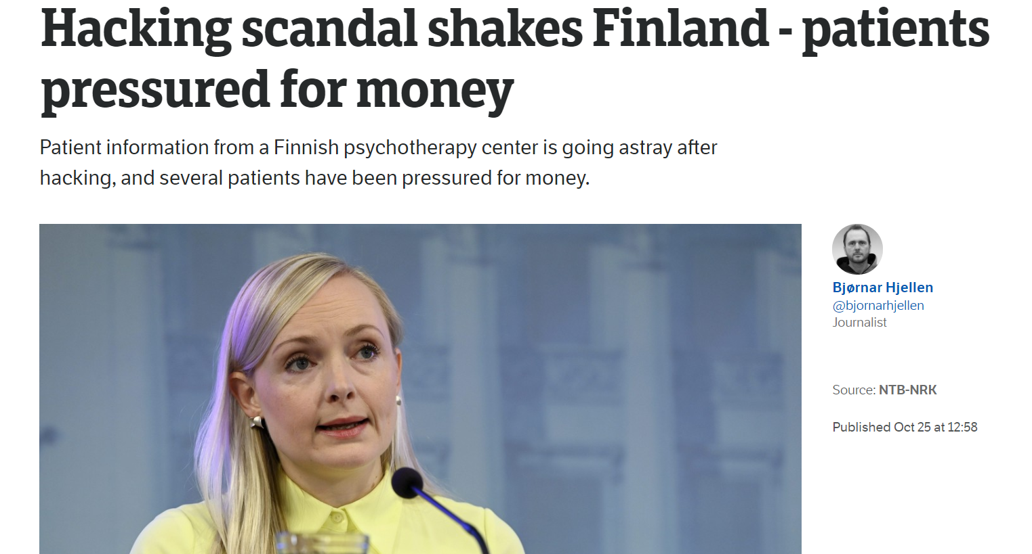

Slide 4
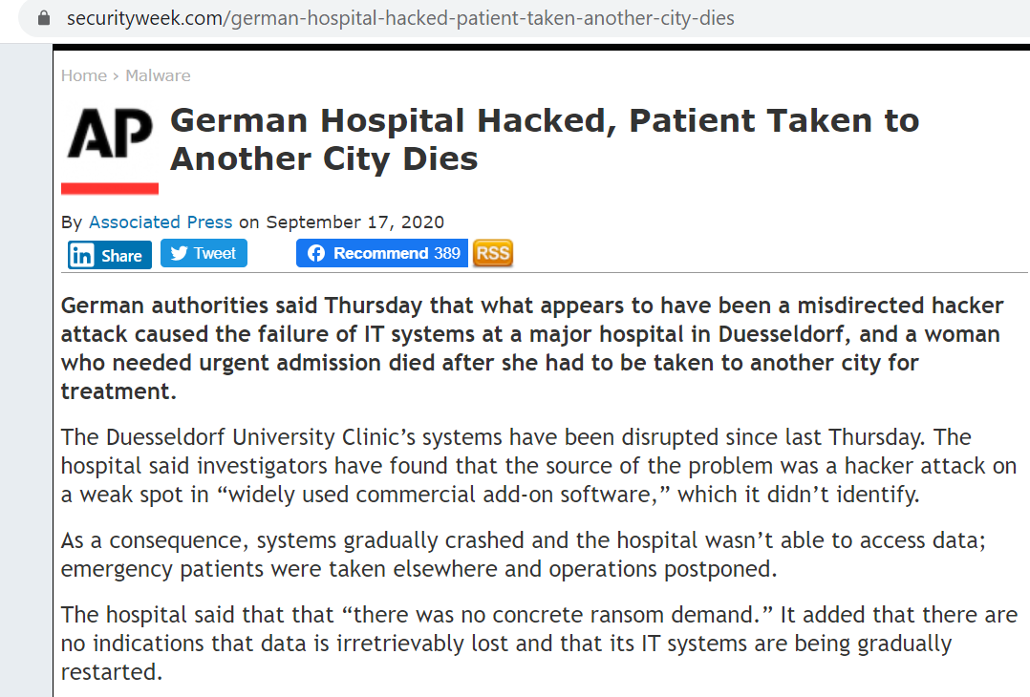

Slide 5
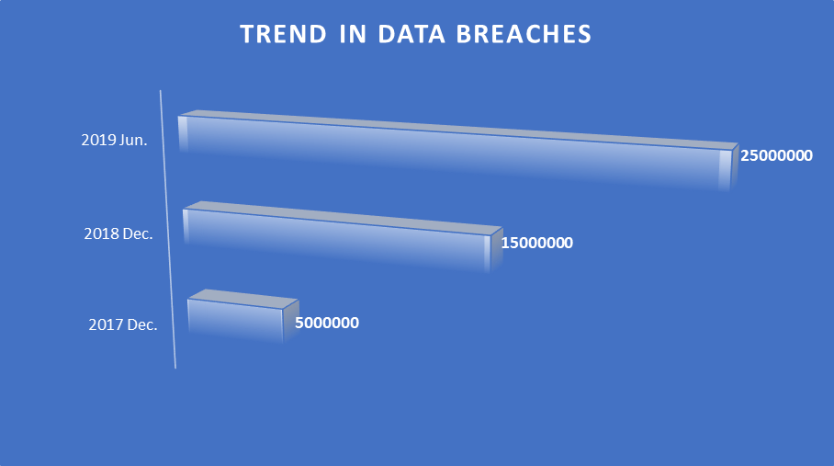

Slide 6
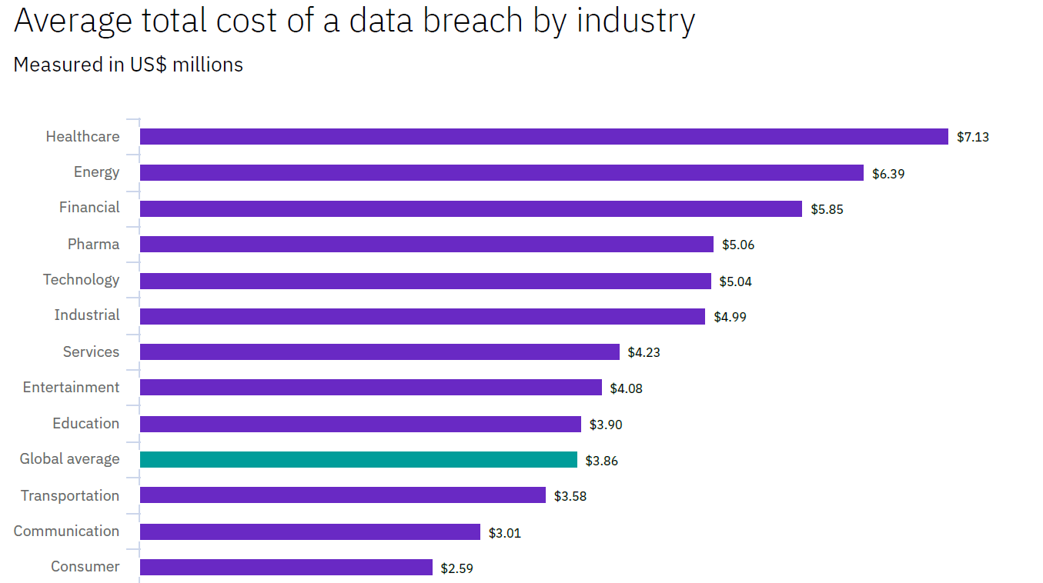

Slide 7
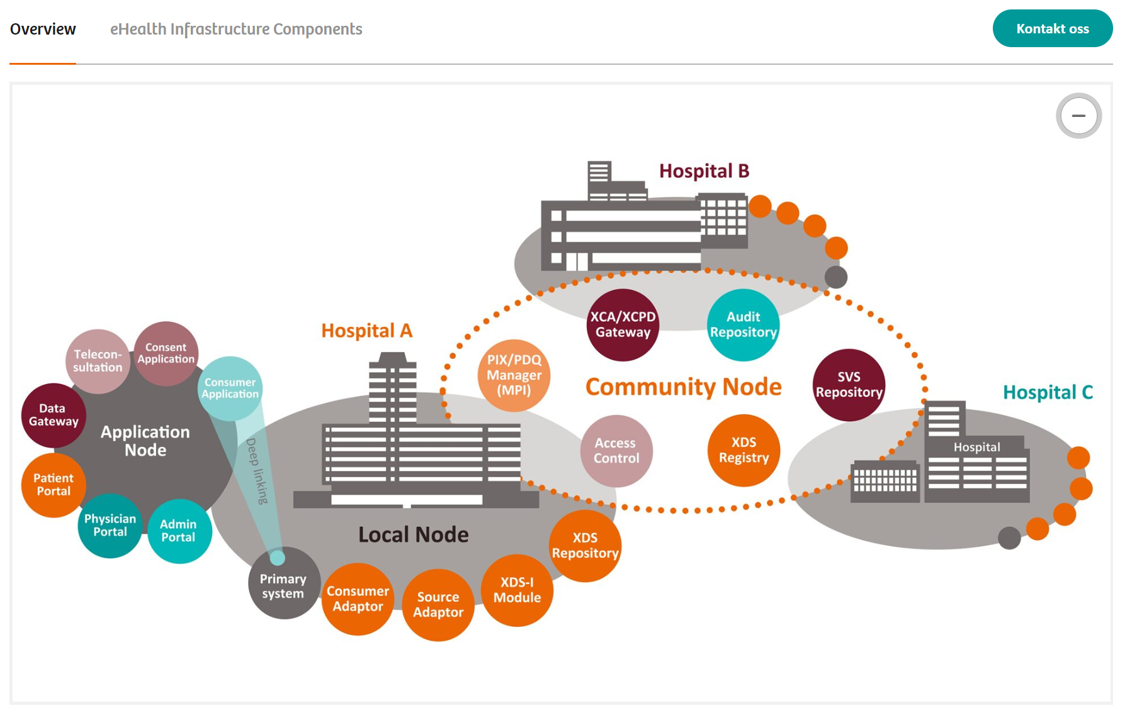
More attention on tech. measures than the human firewall!
Norwegian eHealth infrastructure(Siemens-healthineers, 2018)
security governance configuration,
security planning and policies,
risk management,
And other technology controls
Firewalls
DMZs
IDS/IPS
Antivirus
Other Technologies

Slide 8
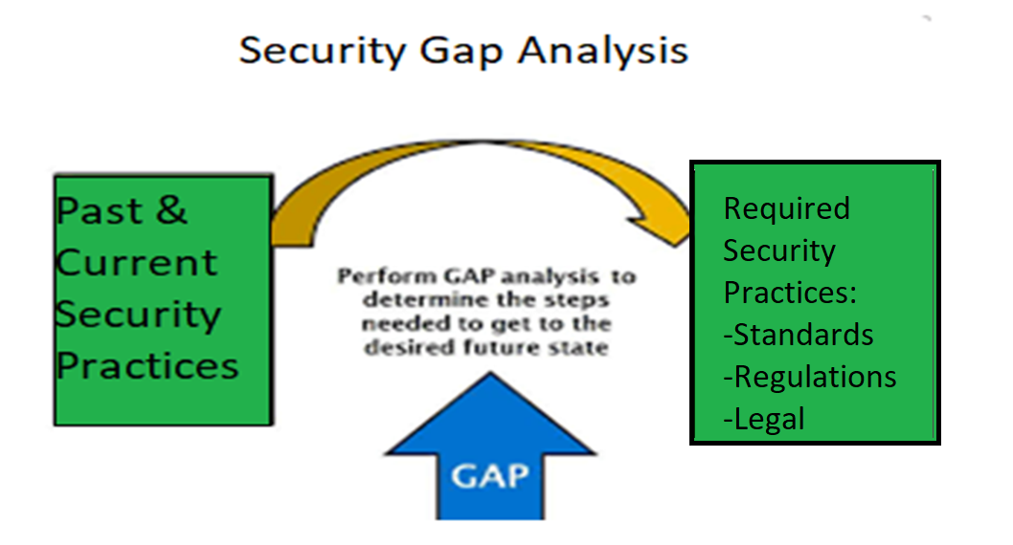
General Goal of HSPAMI

Slide 9
Security practice
Healthcare:
Big data context:
Behaviors required to put up by healthcare staff in order to comply with CIA requirements of information systems
Traces of users’ electronic accesses (logs) which can be reconstructed to form individuals unique access profiles

Slide 10
Data Driven and AI Approach

Slide 11

Security requirement in EHR
Case study: Norway

Slide 12
Scope Research Question and contribution.

Slide 13
Amid various machine learning methods, which of the methods is suitable for analysing healthcare security practice in EHR logs?
Simulated electronic health records logs
Perform comparative analysis of the machine learning classification methods

Slide 14
Method: Data simulation (Normal data)

Slide 15
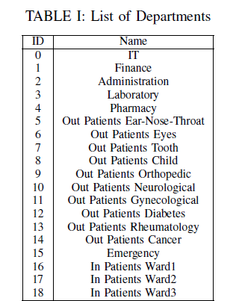

Slide 16
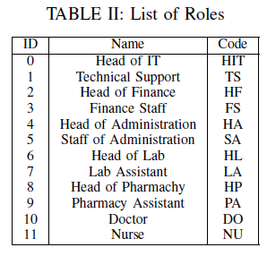

Slide 17
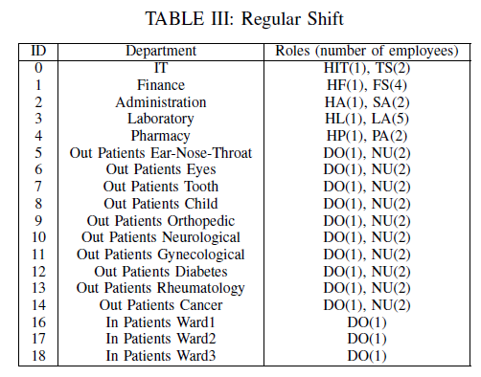
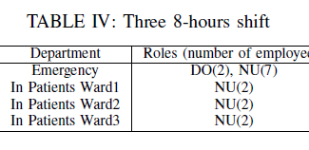

Slide 18
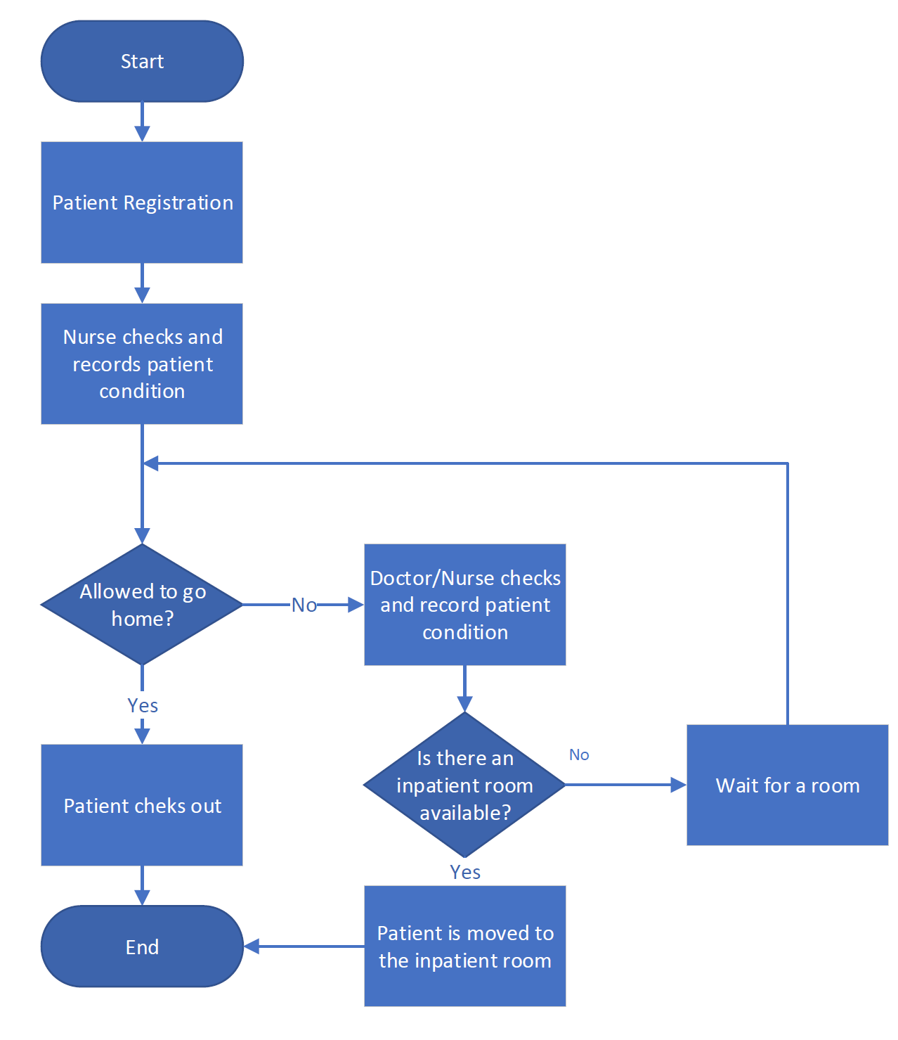
Inpatient flow

Slide 19
EHR rules by the healthcae code of conduct in Norway:
Accessing patients records is only allowed for therapeutic purposes
Access is given to only those with an official need to use,
Self-authorization or ”break the glass” scenarios is allowed but the necessary measures should be provided,
All of the activities related to access of the personal health data (register, update, edit, delete etc )must be logged

Slide 20
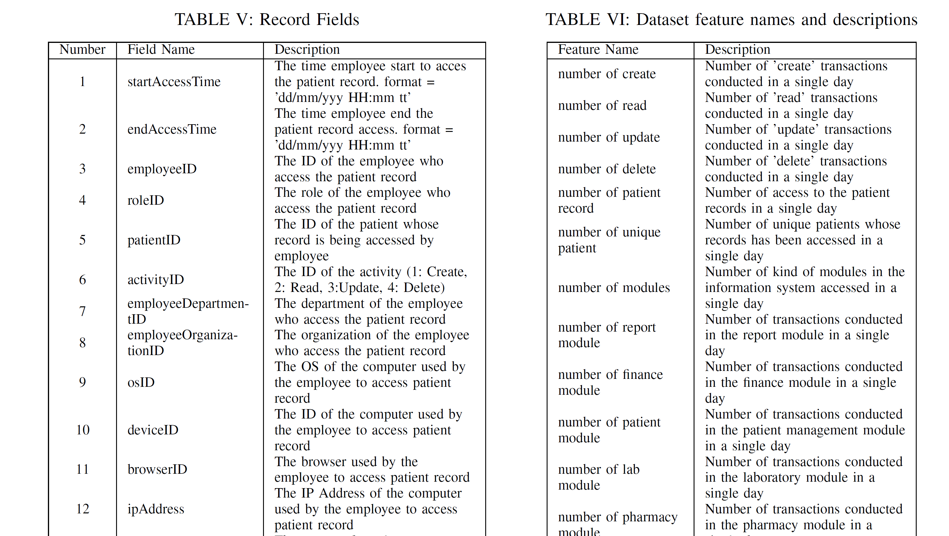
Attributes and features

Slide 21

Abnormal data simulation
Access by identity theft.
The attacker will access more data than legitimate users
Attackers sometimes not follow the flows.

Slide 22
Data Processing cont...
From this data simulation,
283,678 logs were created
Legitimate access were 274,983
Fraudulent access were 8,695

Slide 23
Data Processing cont...
we process the logs data into 24-hour blocks so that an instance represents the
cumulative activity of a user in a single day.
24,286 of them are considered normal
362 of them are considered an anormal

Slide 24
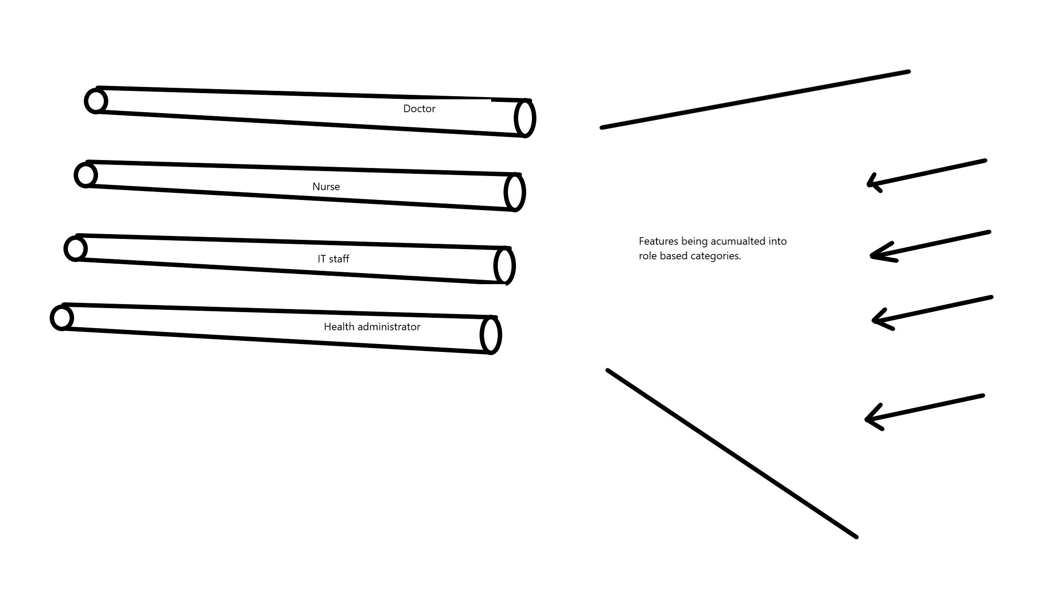
Role classification model
classify the cumulative user activity in a single day into one of the 12 categories
The model was used to classify the cumulative activity of a user in a single
Day
The model was then trained and validated with cross-fold validation

Slide 25
Anomaly Detection
Hard classification
Soft classification
we classify each instance into one category (role)
If an instance is classified into their actual role, then the instance is considered normal.
If the instance was misclassified, then that instance was considered abnormal practice
It gives tolerance for the user to act like users from other roles because some roles have quite similar activities.
The classifier compute the probability of the user’s instance belong to their role class.
If the probability is above a particular threshold, then it is considered normal.
Otherwise, it will be considered an anomaly

Slide 26
Soft classification cont…
The classifier will compute the probability of Doctor A’s cumulative activity in a single day into the Doctor category because his actual role is Doctor.
Then, if the probability is above a particular threshold, then it is considered normal.
Otherwise, it will be considered an anomaly.

Slide 27
Algorithms compared
Multinomial Naive Bayes(multnb),
Bernoulli Naive Bayes (bernnb),
Support Vector Machine (svm),
Neural Network (nn),
K-Nearest Neighbours(knn),
Logistic Regression (lr),
Random Forest (rf),
Decision Tree (dt).

Slide 28
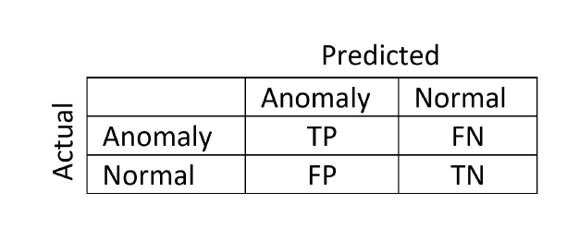
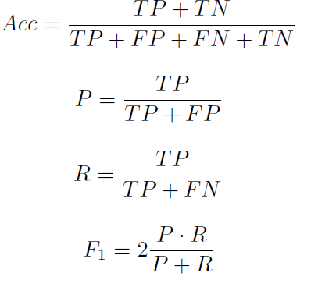
Performance measures
Precision, p: Number of instances that are labeled as anormaly,how many are actually anomaly?
Recall, R: Number of all instances that are actually anomaly, how many of those are correctly predicted
F1 Mesure: is the harmonic mean(average) of the precision and recall

Slide 29
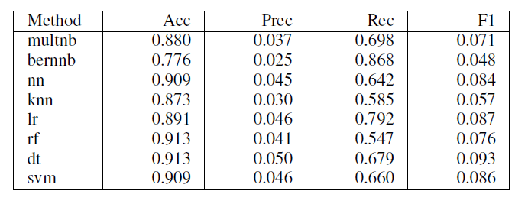
Findings
Hard classification None normalized

Slide 30
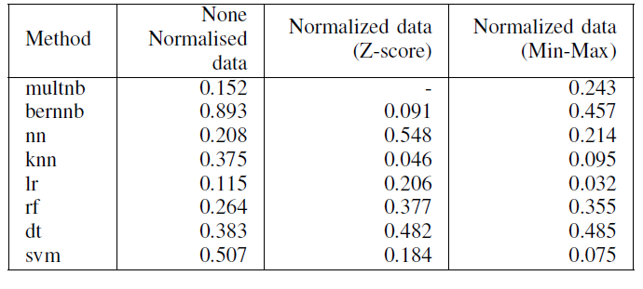
Soft classification (F1- score)

Slide 31
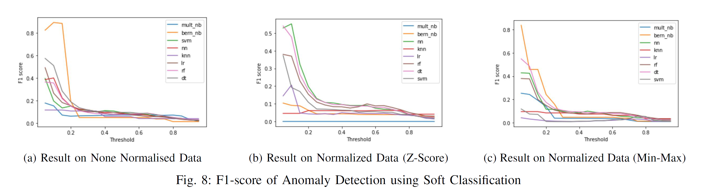
Soft classification (F1- score)…

Slide 32
Performance
Generally, the Soft Classification approach achieved better performance than the Hard Classification approach
Bernoulli Naive Bayes on the None Normalised data performed better with an F1-score of 0.893.

Slide 33
All of the methods obtained a high recall and accuracy but low precision and F1-score.
This high recall means that the method from this work can be a good tool to narrow down the data for further manual investigation.
Soft Classification approach performed better than the Hard Classification approach because it provides some tolerances as roles in different activities can be very similar.

Slide 34
Future works
future works on further processing the anomalies to detect malicious activities.
Additional, as labeled real data can be difficult to get, it is also important to compare unsupervised methods for the detection of anomalies and maliciousness in the context of big data.

Slide 35
Reference
Foroughi, F. and P. Luksch. Observation Measures to Profile User Security Behaviour. in 2018 International Conference on Cyber Security and Protection of Digital Services (Cyber Security). 2018.
ISO, ISO 27799:2016(en), Health informatics Information security management in health using ISO/IEC 27002. 2016.
Nurse, J.R.C., et al. Understanding Insider Threat: A Framework for Characterising Attacks.IEEE Security and Privacy Workshops. 2014.
Boddy, A., et al. A Study into Detecting Anomalous Behaviours within HealthCare Infrastructures. in 2016 9th International Conference on Developments in eSystems Engineering. 2016.
Walker-Roberts, S., M. Hammoudeh, and A. Dehghantanha, A Systematic Review of the Availability and Efficacy of Countermeasures to Internal Threats in Healthcare Critical Infrastructure. IEEE Access, 2018. 6: p. 25167-25177.
e-helse, D.f. Implementation of GDPR in health care sector in Norway. 2019; Available from: https://ehelse.no/personvern-og-informasjonssikkerhet/eus-personvernforordning/implementation-of-gdpr-in-health-care-sector-in-norway.
LOVDATA, Lov om behandling av helseopplysninger ved ytelse av helsehjelp (pasientjournalloven) - Kapittel 3. Taushetsplikt, innsynsrett og rett til å motsette seg behandling av helseopplysninger. 2019.
omsorgsdepartementet, H.-o., Act of 18 May 2001 No. 24 on Personal Health Data Filing Systems and the Processing of Personal Health Data (Personal Health Data Filing System Act), in 042041-990016. 2006, regjeringen.no.
Supervision, N.B.o.H., The Act of 2 July 1999 No. 63 relating to Patients’ Rights (the Patients’ Rights Act) in 63. 1999.
Neuhaus, C., A. Polze, and M. M R Chowdhuryy, Survey on Healthcare IT Systems: Standards, Regulations and Security. 2011.
GDPR.Report, Businesses at risk due to unidentified network traffic according to global survey - GDPR.Report. 2018.
Hipaa Journal, Healthcare Data Breach Statistics. 2019.
Norwegian Centre for E-health Research. Diabetesdagboka.no. 2018; Available from: http://www.diabetesdagboka.no/en/.
EUR-Lex, The European Parliament and the Council of the European Union, Regulation (EU) 2016/679, EU, Editor. 2016.
Pedersen, S. and G. Hartvigsen, Lessons learned from 25 years with telemedicine in Northern Norway. 2015

Slide 36

Thank You For Your Attention!
Questions?
PROSPER K. YENG
PhD. Candidate
Norwegian University of Science and Technology
E-mail: Prosper.Yeng@ntnu.no

